Slide 1

Adolescent Substance Use in Howard County, MD: Needs Assessment & Research Review
Prepared for the Howard County Health Department
Prepared by Rebekah Schrier

Slide 2

Research Focus
  Extent of adolescent substance use in Howard County
  Current services
  Program models across MD & the US

Slide 3


Methodology
Howard County
Needs Assessment
National Research Review
  Interviews
    HCHD Peer Recovery Specialists
    HCPSS Coordinator for Student Support Programs
    Outpatient provider
    Local advocate
  Document review
    Youth Risk Behavior Survey
    HCHD Youth Opioid Response & Prevention Needs Assessment
  Tours/interviews
    Phoenix Recovery Academy
    The Phoenix School
    Recovery & Academic Program
  Research review
    Association of Recovery Schools

Slide 4
Findings

Slide 5

Source: MD Youth Risk Behavior Survey
Notes:
Self-reported; over 1,000 students surveyed
Current use: at least once in the past 30 days

Slide 6
Source: MD Youth Risk Behavior Survey

Slide 7
Current Services
  School
  Community
  Peer Recovery Specialists
  On Our Own of Howard County
  Outpatient
  CRAFFT screening
  Congruent Counseling
  12 step programs
  Sheppard Pratt
  Hilda’s Place
  Grassroots
Notes:
In schools:
Peers
CRAFFT
In the community:
On Our Own - peer support, advocacy education and social contentedness
12 step - aren’t groups for only adolescents; hard to relate
Outpatient providers:
Congruent - Intensive Outpatient Program & Outpatient Groups
IOP: group treatment 3 days a week for 3 hours each day, an individual session every other week, family work, and case management
Sheppard Pratt: outpatient behavioral health services, including drug and alcohol use support groups & education
Hilda’s: diagnosis, treatment, and support for children, adolescents, and young adults
Grassroots: Substance use disorder screening (SBIRT) for youth and then can link to services in the community (but stabilization services only offered to people 18 and older)
~
Gaps: not many for youth under 18
only one residential treatment facility for adolescents in MD: Maryland Teen Rehab operated by Sandstone Care in Crownsville

Slide 8
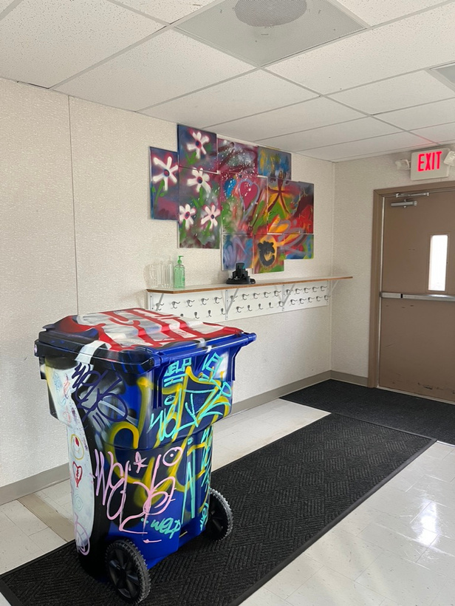
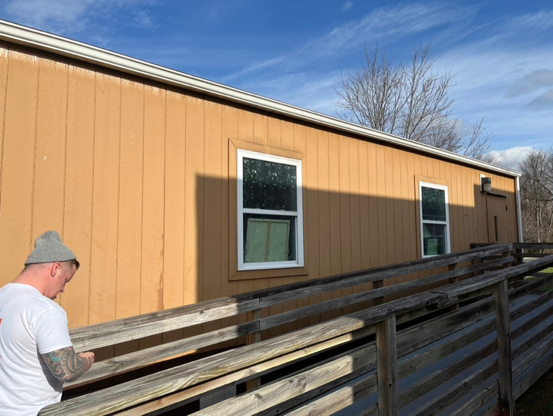
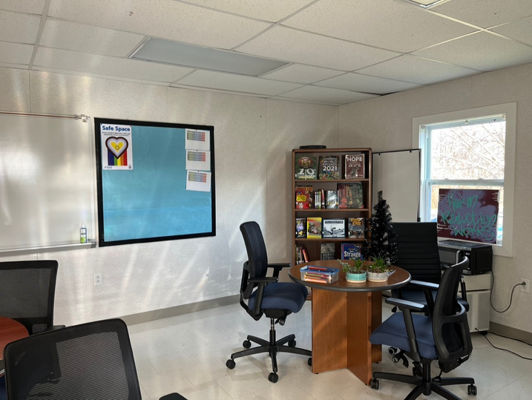
Peer Recovery Specialists
  3 School-based Peers
  Homewood & 1 comprehensive school
Notes:
Started 2021 in Homewood, alternative school
Oct 2022 began working in a comprehensive school
They weren’t aware of any other states or jurisdictions with designated Peers working with students within the standard public schools
Certified: training and service hours; personal experience with substance use or mental health challenges
Employed by HCHD rather than the school system; assures students that conversations will remain confidential
Do need to report abuse and if students intend to harm themselves or others
Relationship building as a core component to developing trust with students and staff
Individualized support to meet students where they are
One-on-one and group meetings
Providing resources
Data highlights: details are in report

Slide 9
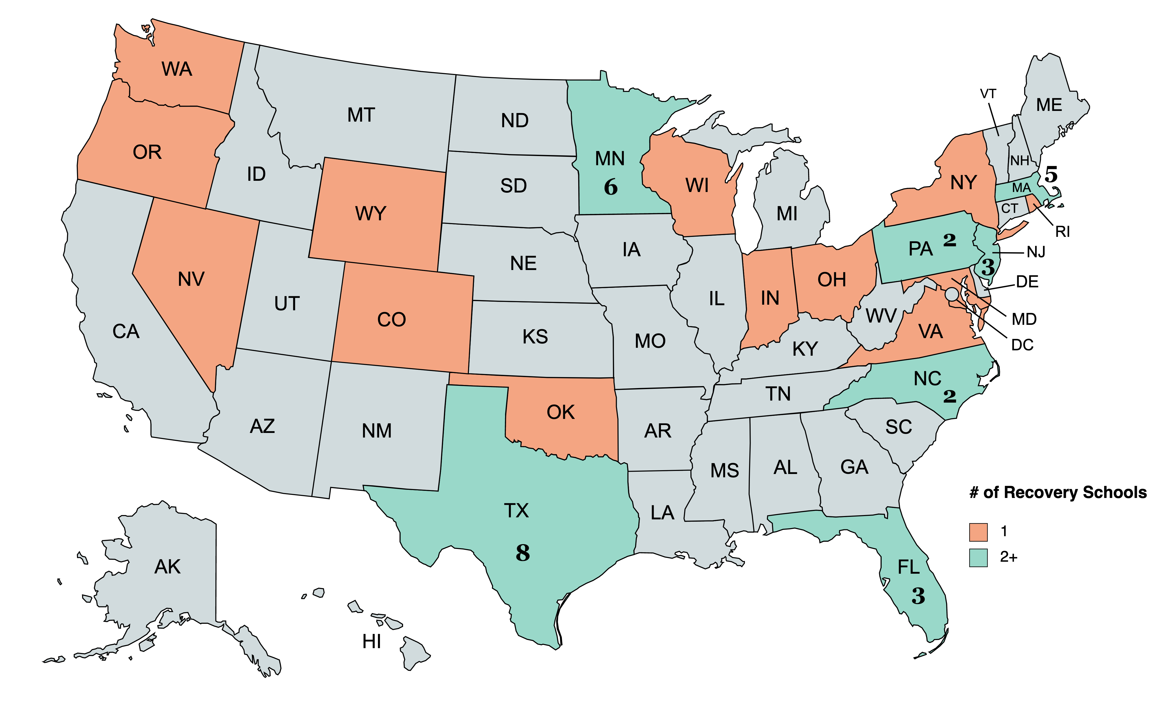
Recovery Schools Across the US
Notes:
Recovery High Schools are “secondary schools designed specifically for students in recovery from substance use disorder or co-occurring disorders”
42 across the US in 20 states
Generation Found, Archway Academy (Houston)
I spoke with Andy Finch, co-founder of the Association of Recovery Schools, who shared published journal articles and a bibliography of over 80 articles/reports
Benefits/findings from studies
Students who attended a RHS had a higher chance of graduating and staying sober compared to peers in comprehensive schools
Later will be discussing components of 3 different schools in VA, CO, & TX

Slide 10
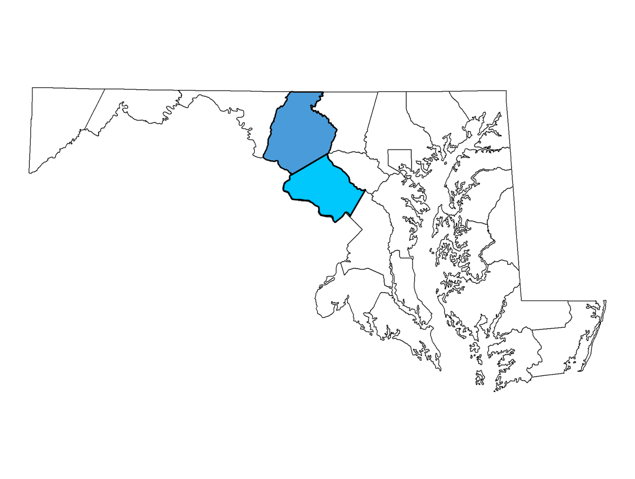
Maryland Programs
PRA
RAP

Slide 11
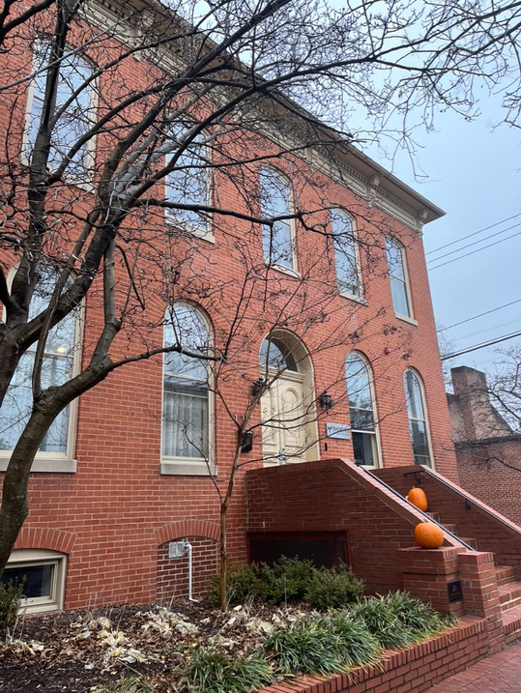
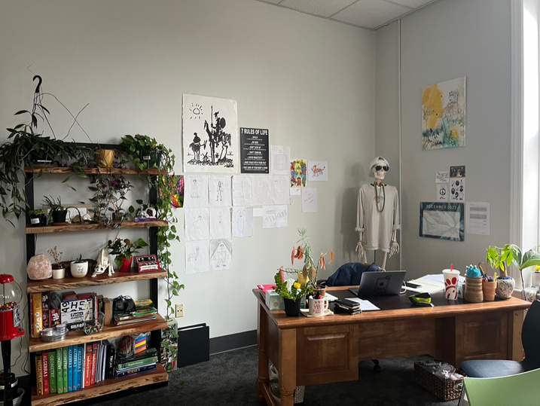
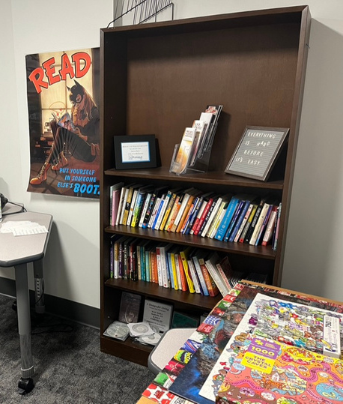
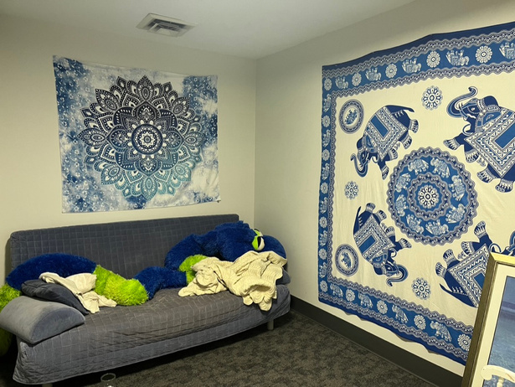
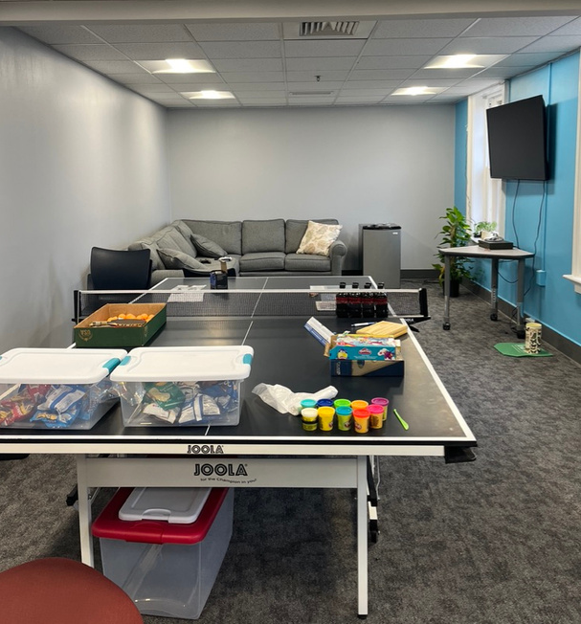
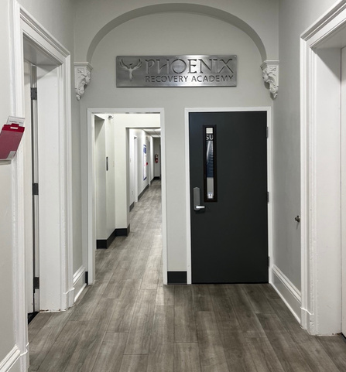
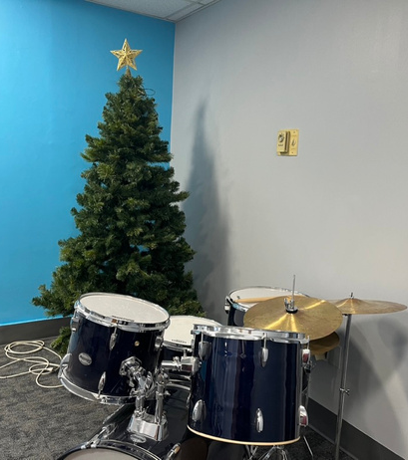
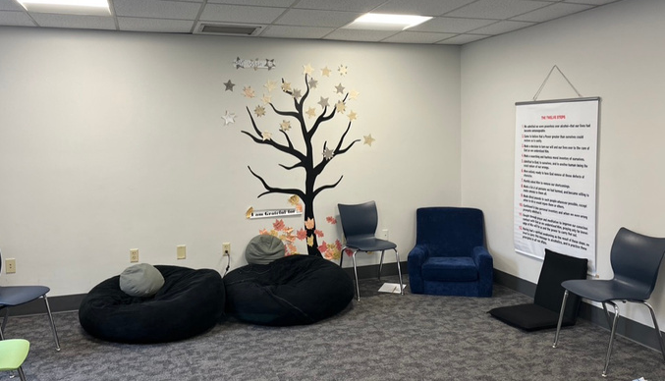
Phoenix Recovery Academy
Frederick, MD
Notes:
currently the only Recovery High School operating in Maryland
opened in August 2020 after five years of fundraising
I toured and spoke with Heather Whitcomb, Executive Director, and Jessica Nicholson, Academy & Community Relations Director
Private high school for students committed to both their education and sobriety
5 students, 2 full time teachers
Academic classes until 3pm, then Alternative Peer Groups from 3-6:30 – led by a Peer Recovery Specialist (recovery group specifically for adolescents to continue on the road to recovery after receiving SU treatment)
Saturday evening groups; Al-Anon meeting for parents
Friday afternoon field trips – go karting, Sugarloaf Mountain

Slide 12

The Phoenix School
Silver Spring & Gaithersburg, MD
Phoenix II
Phoenix I
Notes:
The first Recovery High School in the United States opened in Montgomery County in 1979
I spoke with Brian Berthiaume who founded the school (principal and therapist), Mike Bucci who taught math, Patty Winters – local advocate and leader of Phoenix Rising: Maryland Recovery School Advocates
Public school
Education and sobriety – urinalysis
Parent support group required once a week
outdoor activities
25-35 students each year; 4-5 staff
Success:
Students in recovery isolated from peers who use substances
Students who relapsed were removed and referred to inpatient treatment centers; they could reapply after achieving sobriety and renewing their commitment to it
Parent involvement required
Decline:
Consolidated into existing alternative programs in early 2000s; students in recovery attended school with students who used substances, increasing the challenge of maintaining sobriety
Referrals and enrollment decreased, leading to the program’s closure in 2013

Slide 13
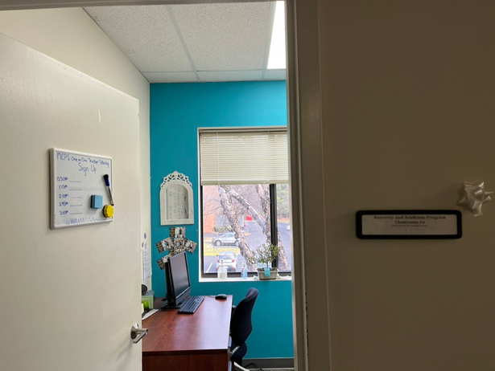
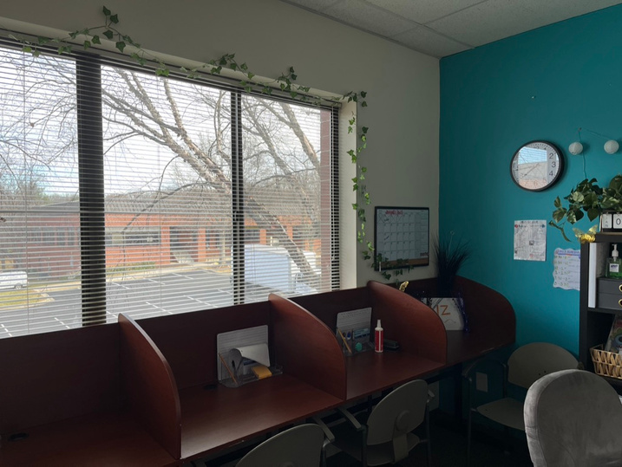
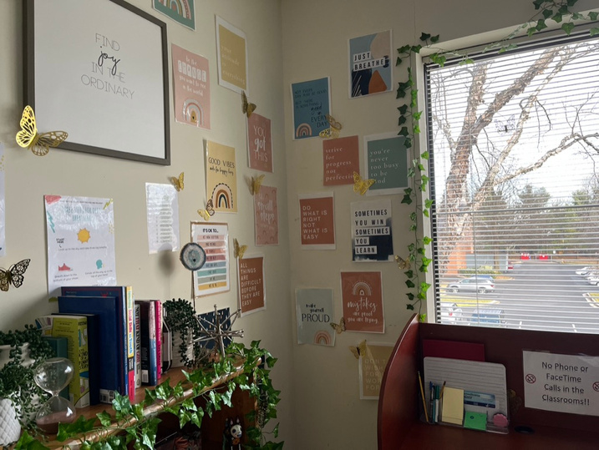
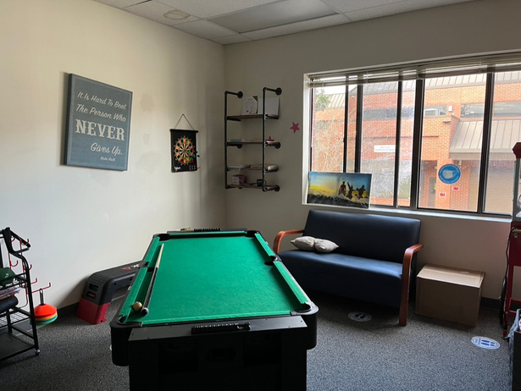
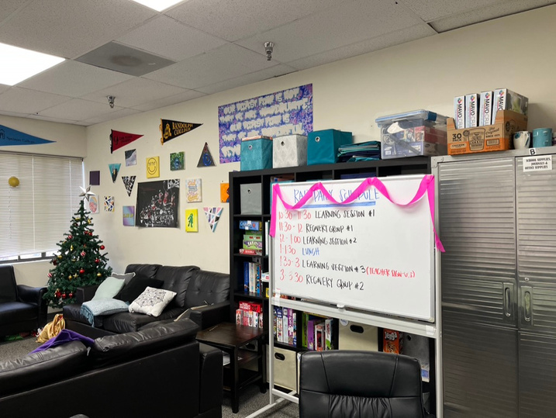
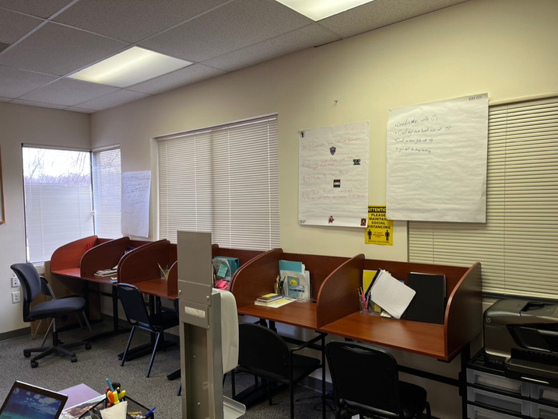
Recovery & Academic Program
Gaithersburg, MD
Notes:
In 2016, Patty Winters and other advocates formed the group Phoenix Rising: Maryland Recovery School Advocates
Their advocacy led to the opening of the Recovery and Academic Program (RAP) in Gaithersburg in 2018
I toured and spoke with Khadija Barkley, RAP’s Principal from MCPS
RAP is a partnership between Montgomery County Public Schools (MCPS) and Sheppard Pratt Health System
Recovery services are provided at The Landing recovery clubhouse
Students can either complete their schoolwork during the day at The Landing or their home school and then go to The Landing afterschool
Online academic curriculum called Edmentum
For recovery, SUPRE curriculum (Substance Use Prevention and Resiliency Education program).
9 students enrolled, capacity of 40; 3 MCPS teachers rotate
Graduate from home school and RAP

Slide 14
Program Comparisons
Program
Components
Phoenix Recovery
Academy
The Phoenix
School
Recovery & Academic
Program
Chesterfield
(VA)
5280 High School
(CO)
Archway Academy
(TX)
Private
Public
Public
Public
Public charter
Public
2 FT teachers
2 FT teachers
3 MCPS teachers rotate
1 FT teacher, hiring
another
Online curriculum
7 FT teachers
Project-based
learning
10 FT teachers
Online &
traditional
Academics
Edmentum online
curriculum
# of students
5
25-35/year
9
13
About 100/yr
About 100/yr
Individualized Plan
Group & individual
therapy sessions
Pass urinalysis
Drug testing
The Landing (Sheppard
Pratt)
Group & individual
sessions w/
substance abuse &
MH counselors
Daily recovery
program
Licensed clinician
Recovery coaches
Peer Groups
Licensed clinician
Recovery coaches
Drug testing
Recovery services
Peer Groups
12 step meetings
Drug testing
SUPRE curriculum
No drug testing
Donations &
foundations
MCPS budget
$200K MD Dept of Ed
grant (OOCC)
$600K State funding
to the School Board
$25K/student/yr
$15K fed, state, local
Adult-use cannabis
market tax
Donations
Donations
Fee: $1,110/mo
Funding
Tuition: $1,150/mo
($13,800/yr)
MCPS budget: $180K
to Sheppard Pratt
Notes:
# students:
5280 – recovery program embedded in the charter school
Archway – opened in 2003
Both still have small class sizes

Slide 15
Considerations
In recovery: Urinalysis required?
Public
Public-private partnership
Private
  Students served
  Accessibility
Prevention
Current use
Recovery
Recovery staff
Teachers
Administrators
  Goals of program
  Staff
Opioid Abatement Fund
Cannabis tax
HCPSS / State appropriation
Grants/donations
HCPSS: $17K/student/yr
RHS: $25K/student/yr
  Cost
  Funding
  Location
Own building
Within existing school/program
  Family involvement
Required?
Notes:
Students served:
Exclusive for students in recovery who are committed to their sobriety?
Require urinalysis?
Accessibility
Public
Public-private partnership
Private – restricted to students who can afford it
Goals
Prevention
Addressing current use
Recovery
Staff
Peers
Licensed counselors
Teachers
Administration
Cost
HCPSS currently spends about $17,000/student/year
Recovery schools typically cost about $25-30,000/student/year
Compared to residential treatment, Recovery Schools are a better financial investment
Funding
Opioid Abatement Fund; budget recommendations to be made by the Opioid Collaborative Community Council before June 30
Community reinvestment from adult-use cannabis market tax
Oregon (Harmony Academy) and Colorado (5280 High School) designated cannabis tax revenue to fund recovery schools
HCPSS budget
State appropriation - like VA
Grants/donations
Location
Own building
Students in recovery surrounded by similar peers
More costly unless location donated
Within existing school
Lower operational costs; more classes
Students in recovery could interact with those not – ex. Phoenix started in its own building and was successful, then started declining when it moved into a building with existing alternative programs
Within existing program/nonprofit
RAP – The Landing
Family involvement required or not?

Slide 16
Thanks for listening!
Questions?

